Slide 1

Geometry
Unit 1, Lesson 3 Isometry Volume 1, pg. 13

Slide 2


Benchmark
MA.912.GR.2.2
Identify transformations that do or do not preserve distance.
volume 1, pg. 13

Slide 3
Integrated Mathematical Thinking and Reasoning Standards
MA.K12.MTR.1.1 Actively participate in effortful learning both individually and collectively.
MA.K12.MTR.2.1 Demonstrate understanding by representing problems in multiple ways.
MA.K12.MTR.4.1 Engage in discussions that reflect on the mathematical thinking of self and others.
MA.K12.MTR.5.1 Use patterns and structure to help understand and connect mathematical concepts.
volume 1, pg. 13

Slide 4

Learning Targets
I can define rigid motions.
I can show rigid motions by mapping using arrows on the plane.
I can explain why isometry preserves distance.
volume 1, pg. 13

Slide 5

Warm-Up
volume 1, pg. 13

Slide 6

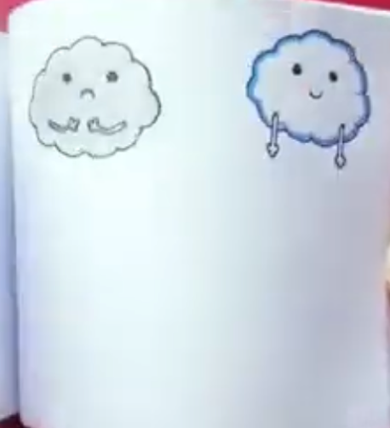
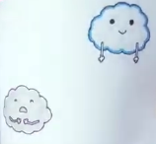
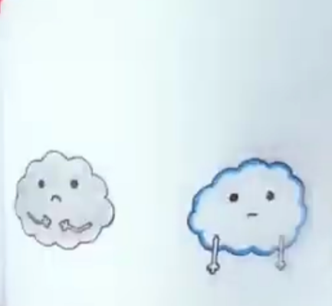
1.3.1 Warm-Up: Animation Flipbook
An animation flipbook is a small book of drawings with a series of pictures that appear to move when the pages are flipped in rapid succession.
The video shows a series of pictures of two clouds. A few screenshots are shown.
volume 1, pg. 13

Slide 7
What do you notice about the two clouds?
At one point the two clouds seemed to move up and down. How do you think the artist was able to do that?
volume 1, pg. 13

Slide 8

Exploration
volume 1, pg. 14

Slide 9

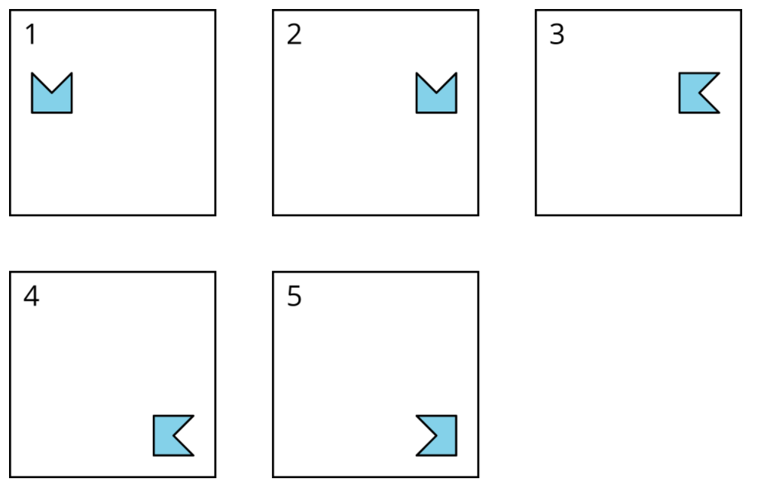
1.3.2 Exploration: Isometry
Work with your partner to complete the following.
Five frames that feature a polygon in different positions are shown.
volume 1, pg. 14

Slide 10
Describe how the polygon moves from one frame to the next.
Movement from… | Description
Frame 1 to Frame 2
Frame 2 to Frame 3
Frame 3 to Frame 4
Frame 4 to Frame 5
volume 1, pg. 14

Slide 11

The diagram shows the position of the polygon from Frame 1.
Label two pieces of patty paper as A and B. Then,
complete the steps for each piece of patty paper.
Patty paper A
Copy the polygon.
Move patty paper A to display the polygon as it is shown in Frame 2.
Patty paper B
Copy the polygon and the square that surrounds it.
Fold the patty paper vertically so that the top corners of the square match up.
With the patty paper folded, draw the copy of the polygon onto the other half of the patty paper.
volume 1, pg. 14

Slide 12
Complete the statements.
To draw the polygon as it is shown in Frame 2, patty paper A was moved
When patty paper B was folded, the polygon could be traced so that the new polygon is as shown in Frame 2.
The original polygon was the fold of the paper.
The fold of the paper was the
up.
left.
right.
down.
flipped across
rotated around
center of rotation.
line of reflection.
volume 1, pg. 15

Slide 13

The diagram shows where the polygon is in Frame 2.
Complete the steps to find the point of rotation.
Label a piece of patty paper as C.
Copy the polygon onto patty paper C.
Use the point of your writing utensil to find the point of rotation so the polygon can be rotated to look like Frame 3.
Place a dot on the diagram above to show the point of rotation.
Place patty paper C on the circular graph paper so the point of rotation is where the two red axes meet, and the polygon is oriented as in Frame 2.
Rotate patty paper C so that it looks like Frame 3.
volume 1, pg. 15

Slide 14
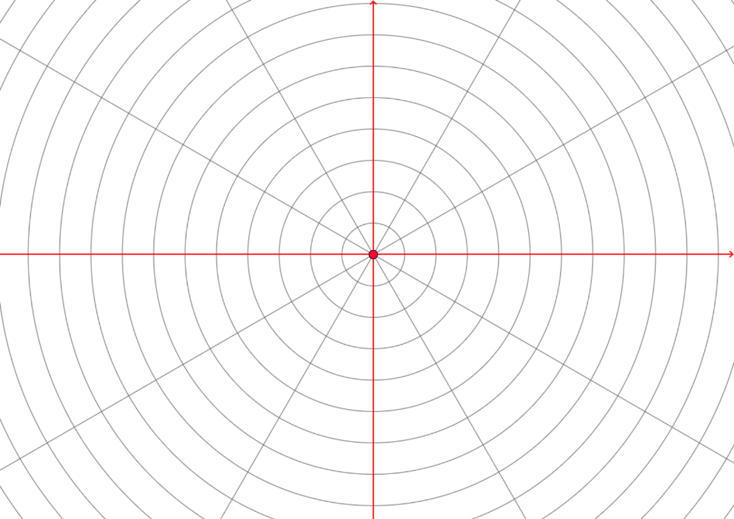











$$120°$$
$$90°$$
$$60°$$
$$150°$$
$$30°$$
$$180°$$
$$210°$$
$$330°$$
$$240°$$
$$300°$$
$$270°$$
volume 1, pg. 16

Slide 15
Complete the statements.
To move the polygon so it looks like Frame 3, rotate the diagram on patty paper C ______ degrees clockwise  or ______ degrees counterclockwise . The center of rotation is
the top left vertex.
the top right vertex.
the bottom left vertex.
the bottom right vertex.
the center of the polygon.
volume 1, pg. 16

Slide 16
Use patty paper, a ruler, or a protractor as necessary to complete the following.
Complete the table by determining if the polygon changed in size or shape as it moved.
Movement from… | Did the size change? | Did the shape change?
Frame 1 to Frame 2
Frame 2 to Frame 3
Frame 3 to Frame 4
Frame 4 to Frame 5
volume 1, pg. 16

Slide 17
What tools or information were used when determining if the size changed?
What tools or information were used when determining if the shape changed?
Discuss with your partner if the measurement of angles in the polygon changed from Frame 1 to Frame 5.
volume 1, pg. 16

Slide 18

Bring It Together
volume 1, pg. 17

Slide 19


1.3.3 Bring It Together: Definitions
The movements of the polygon in the five frames are known as reflection, rotation, and translation. During the lesson a reflection was referred to as a flip, which is an informal definition. Another informal definition used was “is moved,” which is formally known as a translation.
A reflection is a transformation that produces the mirror image of a geometric figure across a line of reflection.
volume 1, pg. 17

Slide 20


A rotation is a transformation of a figure by turning it about a center point or axis. The amount of rotation can be expressed in the number of degrees. The direction of the rotation for two-dimensional figures can be expressed as clockwise or counterclockwise.
A translation is a transformation in which every point in a figure is moved in the same direction and by the same distance.
Isometry is a transformation that preserves distance and angle measure.
volume 1, pg. 17

Slide 21

Discuss with your partner the definition of isometry. Determine which transformations — reflection, rotation, or translation — preserve distance and angle measure. Summarize your discussion.
A rigid transformation is a transformation of points in space consisting of a sequence of one or more translations, reflections, or rotations. Rigid transformations preserve distances and angle measures (congruency).
volume 1, pg. 17

Slide 22


A rigid transformation is also called a rigid motion. Rigid means that something is not able to be changed. Isometry is composed of rigid motions.
Figures having exactly the same shape and size are congruent. Equivalently, two figures are congruent if one can be mapped to the other using a rigid transformation.
volume 1, pg. 17

Slide 23

Collaboration
volume 1, pg. 18

Slide 24

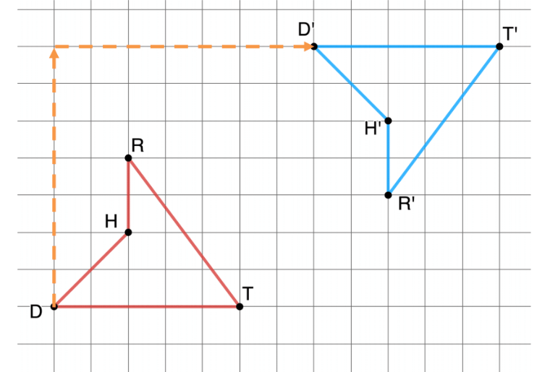
1.3.4 Collaboration: Isometry
A diagram of $RTDH$ and $R′T′D′H′$ is shown. Arrows are drawn from vertex $D$ to vertex $D′$.
volume 1, pg. 18

Slide 25

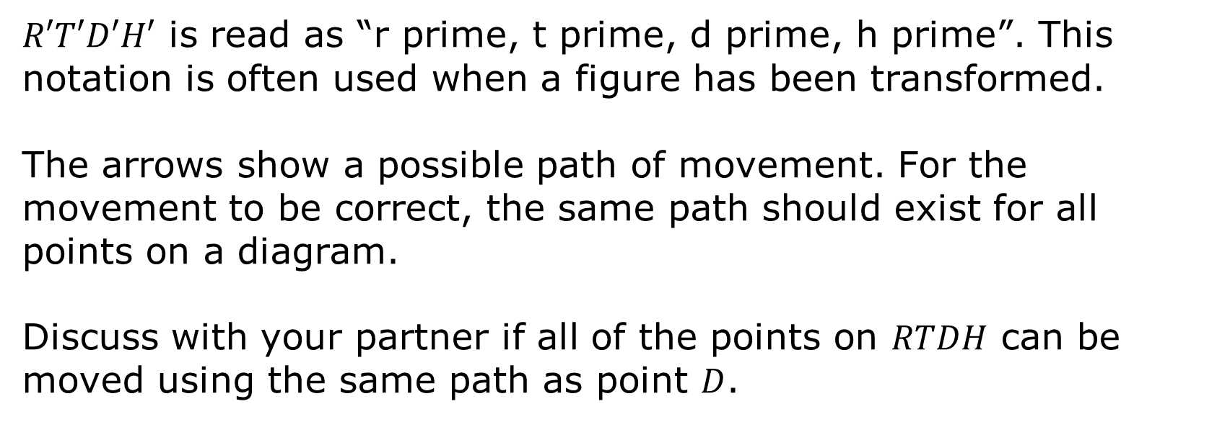
$R′T′D′H′$ is read as “r prime, t prime, d prime, h prime”. This notation is often used when a figure has been transformed.
The arrows show a possible path of movement. For the movement to be correct, the same path should exist for all points on a diagram.
Discuss with your partner if all of the points on $RTDH$ can be moved using the same path as point $D$.
A mapping is a standardized form of showing a transformation.
volume 1, pg. 18

Slide 26
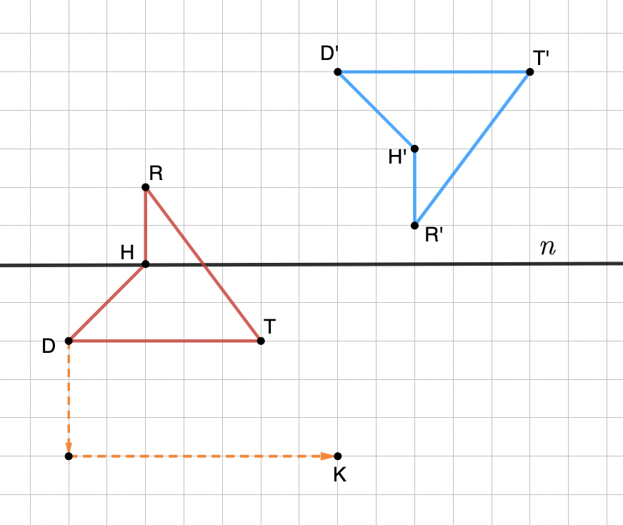
A diagram of $RTDH$ and $R′T′D′H′$ is shown. Arrows are drawn from vertex $D$ to point $K$.
volume 1, pg. 18

Slide 27
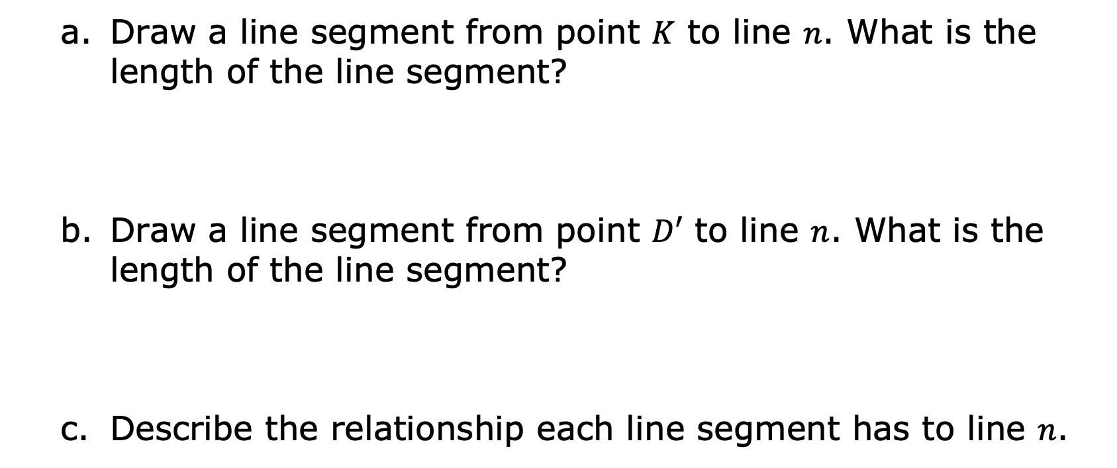
Draw a line segment from point $K$ to line $n$. What is the length of the line segment?
Draw a line segment from point $D′$ to line $n$. What is the length of the line segment?
Describe the relationship each line segment has to line $n$.
volume 1, pg. 18

Slide 28
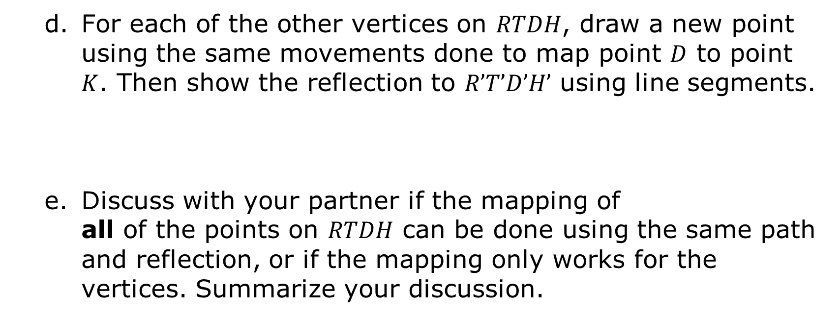
If corresponding points have the same distance from a line then the line is the “line of reflection.”
For each of the other vertices on $RTDH$, draw a new point using the same movements done to map point $D$ to point $K$. Then show the reflection to $R’T’D’H’$ using line segments.
Discuss with your partner if the mapping of all of the points on $RTDH$ can be done using the same path and reflection, or if the mapping only works for the vertices. Summarize your discussion.
volume 1, pg. 19

Slide 29

Wrap-Up
volume 1, pg. 19

Slide 30
1.3.5 Wrap-Up: Reflection
Complete the table.
The terms and information used in the exploration that I knew were … | Something I wondered during the exploration was … | Something I learned during the exploration was …
volume 1, pg. 19

